Slide 1
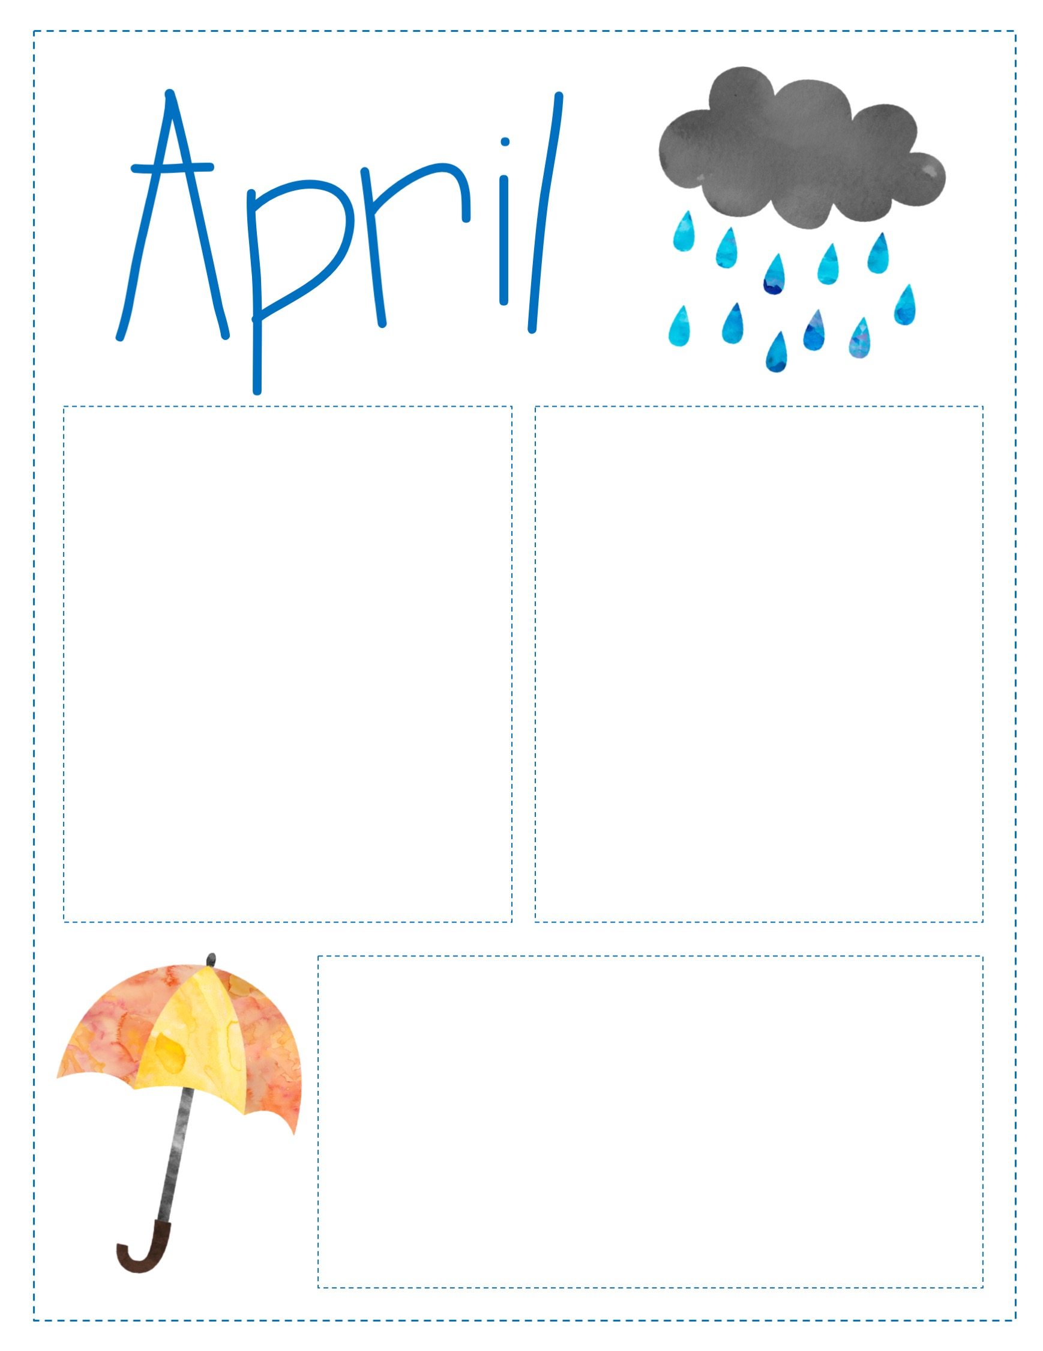
Look at what we’re Learning:
Reading: STAAR preparation in Reading and Writing
Math: 2 and 3 Dimensional figures; Cumulative Review
HOLIDAYS:
April 10: Bunny pictures
April 13: Math and Science night from 4:00 to 5:30pm
April 15: Last Saturday tutorials
April 21: Spring Holiday
April 24: STAAR prep Rally from 1:30 to 2:30
April 25-28 STAAR reading and writing test
CONTACT INFORMATION:
Conference Period 12:58 – 1:53 p.m.
Ms. Moore jmoore7@houstonisd.org
Ms. Stewart Delores.Stewart@houstonisd.org

